Slide 1
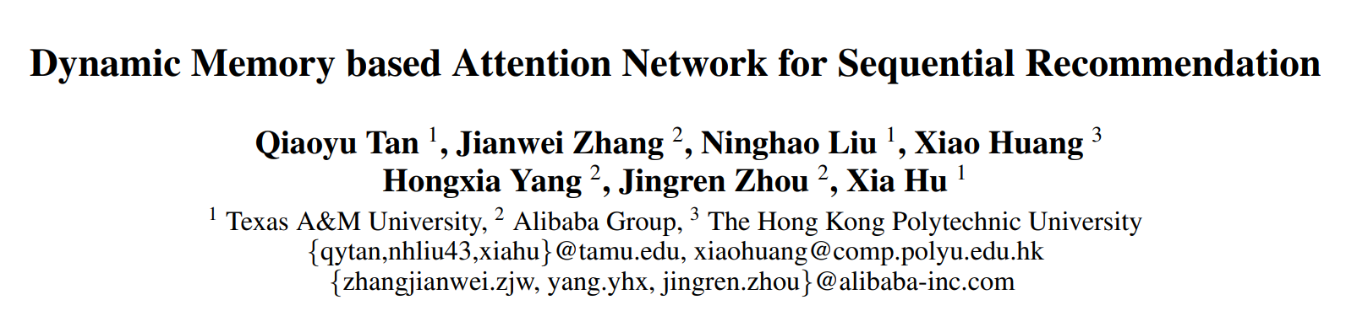

Slide 2
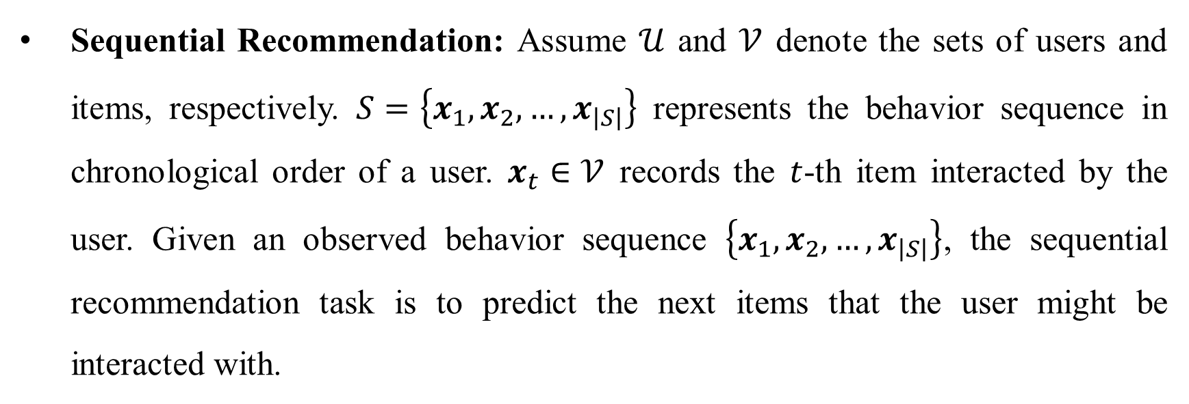
Problem Formulation
Sequential Recommendation: Assume $𝒰$ and $𝒱$ denote the sets of users and items, respectively. $S=\left\{x_{1},x_{2},…,x_{\left|S\right|}\right\}$ represents the behavior sequence in chronological order of a user. $x_{t}∈𝒱$ records the $t$-th item interacted by the user. Given an observed behavior sequence $\left\{x_{1},x_{2},…,x_{\left|S\right|}\right\}$, the sequential recommendation task is to predict the next items that the user might be interacted with.

Slide 3
Challenges
Given that the response time in real-world systems is limited, it has become expensive to scan over the entire behavior sequence at each prediction time.
It is crucial to model the whole behavior sequence for a more accurate recommendation.
It is hard to explicitly control the contributions of long-term or short-term interests for user modeling.

Slide 4
Methodology
Truncating the whole user behavior sequence into several successive sub-sequences and optimizes the model sequence by sequence.
A recurrent attention network and a long-term attention network with dynamic memory are derived for short-term and long-term interest modeling.
A gate mechanism is applied to adaptively control the importance of the above two interests combination.

Slide 5
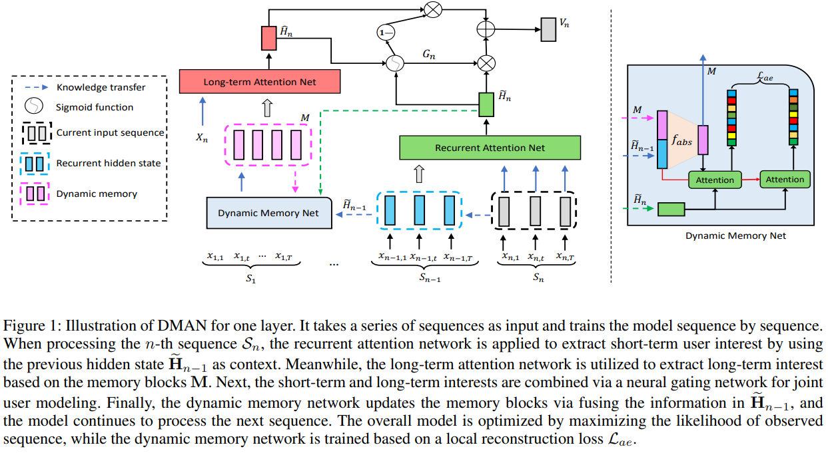
Dynamic memory-based self-attention network (DMAN)

Slide 6
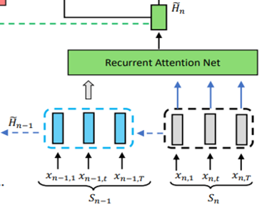
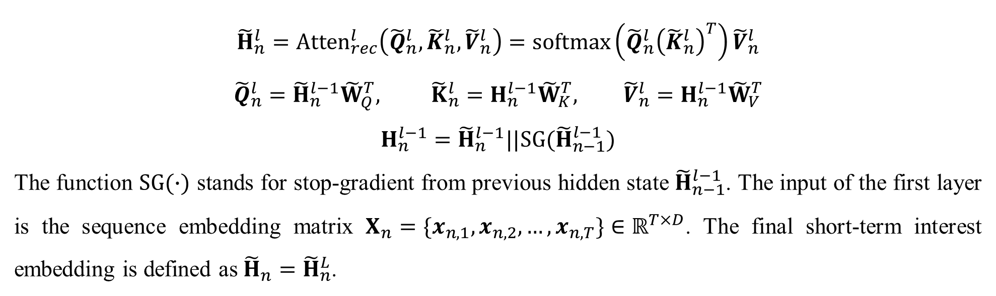
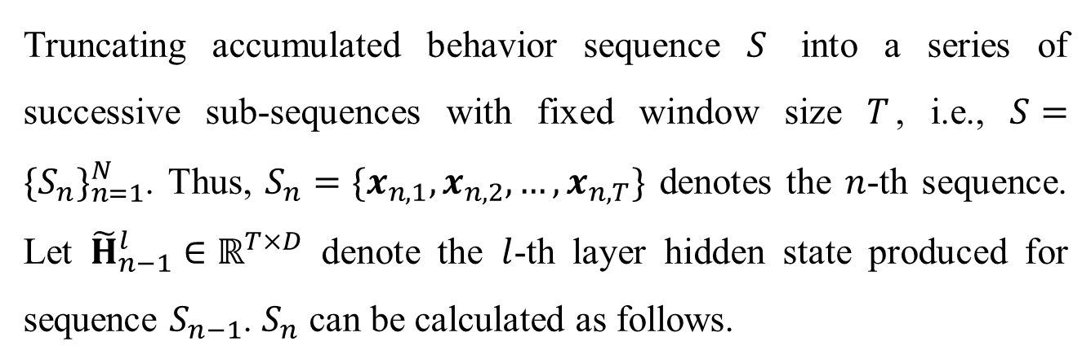
Recurrent Attention Network
Truncating accumulated behavior sequence $S$ into a series of successive sub-sequences with fixed window size $T$, i.e., $S={\{S_{n}\}}_{n=1}^{N}$. Thus, $S_{n}=\{x_{n,1},x_{n,2},…,x_{n,T}\}$ denotes the $n$-th sequence. Let ${\tilde{H}}_{n−1}^{l}∈ℝ^{T×D}$ denote the $l$-th layer hidden state produced for sequence $S_{n−1}$. $S_{n}$ can be calculated as follows.
$${\tilde{H}}_{n}^{l}={Atten}_{rec}^{l}\left({\tilde{Q}}_{n}^{l},{\tilde{K}}_{n}^{l},{\tilde{V}}_{n}^{l}\right)=softmax\left({\tilde{Q}}_{n}^{l}{\left({\tilde{K}}_{n}^{l}\right)}^{T}\right){\tilde{V}}_{n}^{l}$$
$${\tilde{Q}}_{n}^{l}={\tilde{H}}_{n}^{l−1}{\tilde{W}}_{Q}^{T}, {\tilde{K}}_{n}^{l}=H_{n}^{l−1}{\tilde{W}}_{K}^{T}, {\tilde{V}}_{n}^{l}=H_{n}^{l−1}{\tilde{W}}_{V}^{T}$$
$$H_{n}^{l−1}={\tilde{H}}_{n}^{l−1}||SG({\tilde{H}}_{n−1}^{l−1})$$
The function $SG(∙)$ stands for stop-gradient from previous hidden state ${\tilde{H}}_{n−1}^{l−1}$. The input of the first layer is the sequence embedding matrix $X_{n}=\{x_{n,1},x_{n,2},…,x_{n,T}\}∈ℝ^{T×D}$. The final short-term interest embedding is defined as ${{\tilde{H}}_{n}=\tilde{H}}_{n}^{L}$.

Slide 7
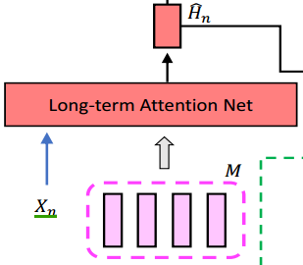
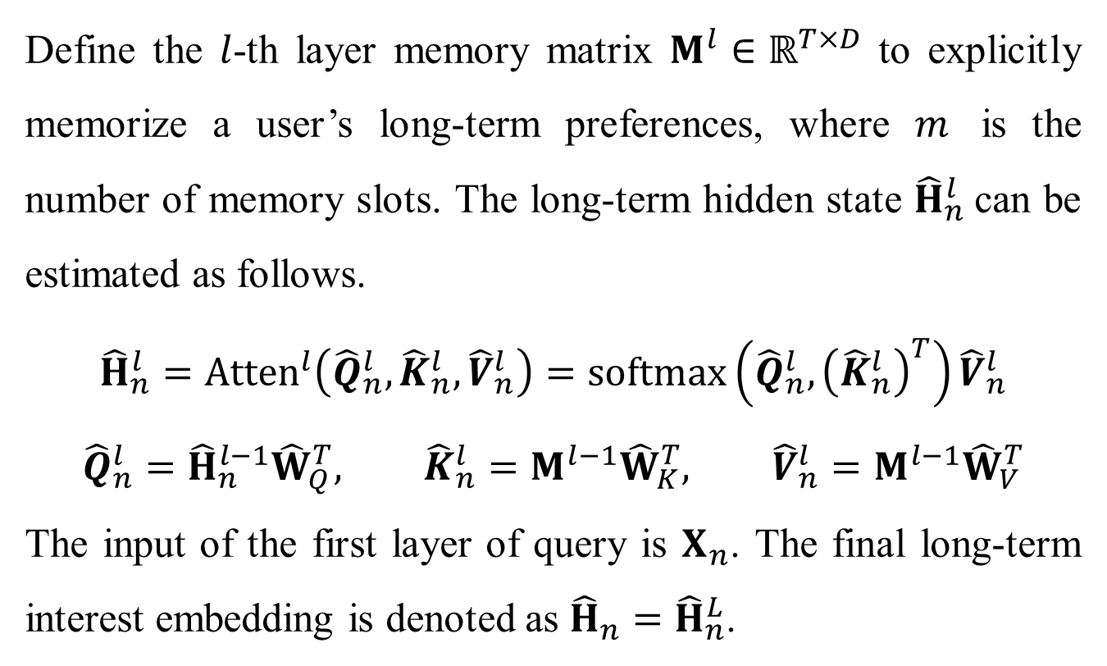
Long-term Attention Network
Define the $l$-th layer memory matrix $M^{l}∈ℝ^{T×D}$ to explicitly memorize a user’s long-term preferences, where $m$ is the number of memory slots. The long-term hidden state ${\hat{H}}_{n}^{l}$can be estimated as follows.
$${\hat{H}}_{n}^{l}={Atten}^{l}\left({\hat{Q}}_{n}^{l},{\hat{K}}_{n}^{l},{\hat{V}}_{n}^{l}\right)=softmax\left({\hat{Q}}_{n}^{l},{\left({\hat{K}}_{n}^{l}\right)}^{T}\right){\hat{V}}_{n}^{l}$$
$${\hat{Q}}_{n}^{l}={\hat{H}}_{n}^{l−1}{\hat{W}}_{Q}^{T}, {\hat{K}}_{n}^{l}=M^{l−1}{\hat{W}}_{K}^{T}, {\hat{V}}_{n}^{l}=M^{l−1}{\hat{W}}_{V}^{T}$$
The input of the first layer of query is $X_{n}$. The final long-term interest embedding is denoted as ${{\hat{H}}_{n}=\hat{H}}_{n}^{L}$.

Slide 8
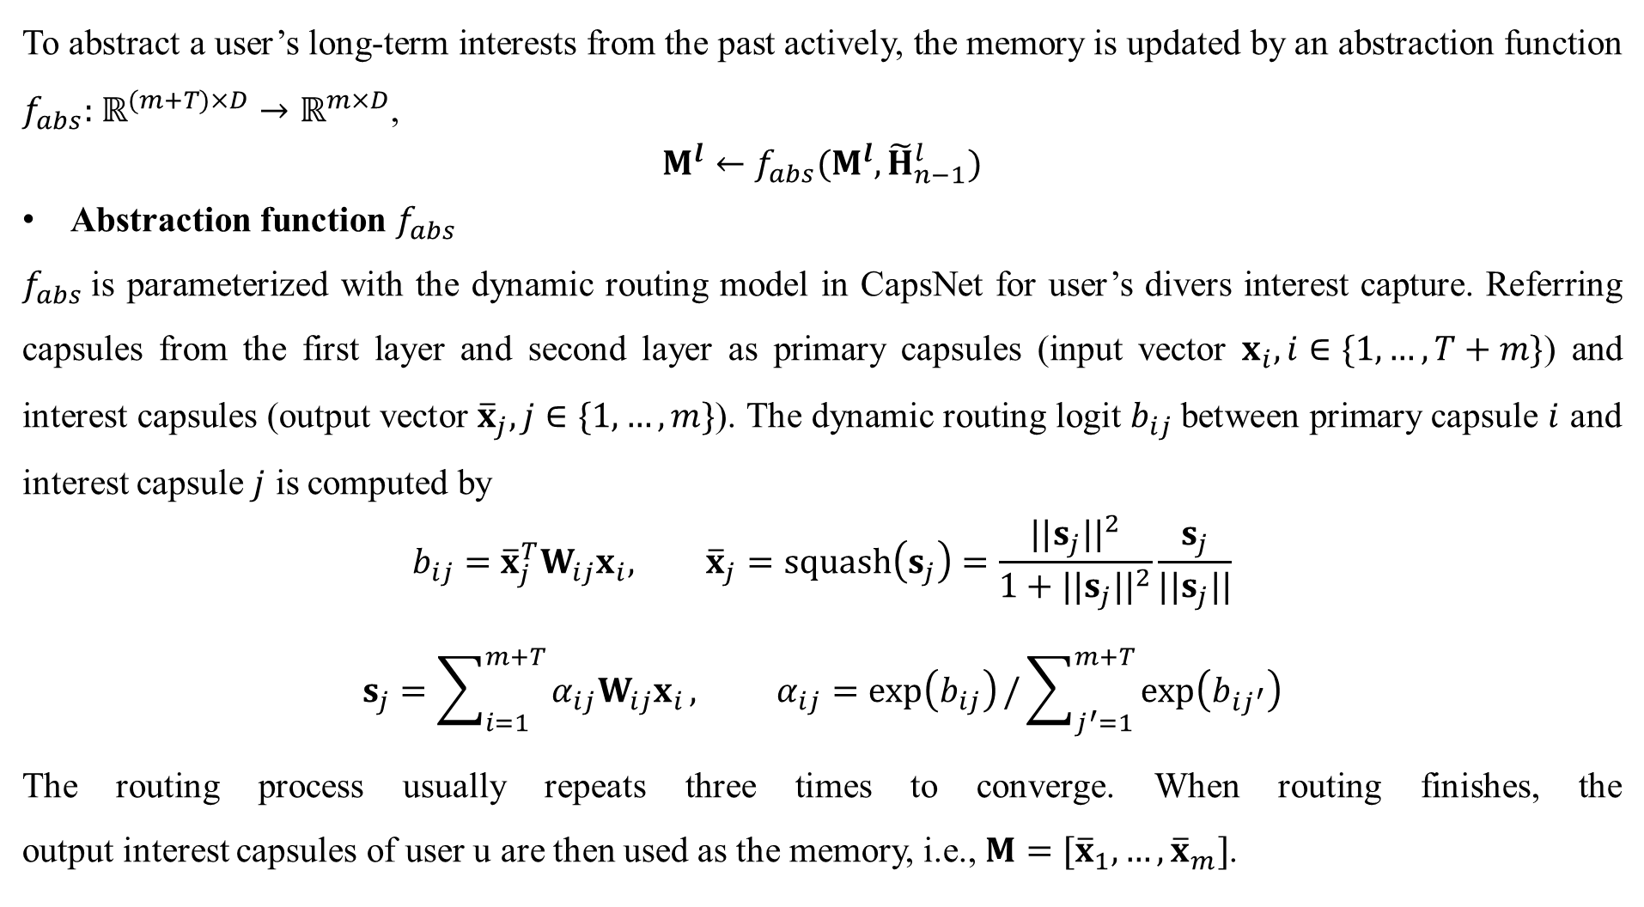
Dynamic Memory Network
To abstract a user’s long-term interests from the past actively, the memory is updated by an abstraction function $f_{abs}:$ $ℝ^{(m+T)×D}→$ $ℝ^{m×D}$,
$M^{l}←f_{abs}(M^{l},{\tilde{H}}_{n−1}^{l})$
Abstraction function $f_{abs}$
$f_{abs}$is parameterized with the dynamic routing model in CapsNet for user’s divers interest capture. Referring capsules from the first layer and second layer as primary capsules (input vector $x_{i}, i∈\{1,…,T+m\}$) and interest capsules (output vector ${\overline{x}}_{j},j∈\{1,…,m\}$). The dynamic routing logit $b_{ij}$ between primary capsule $i$ and interest capsule $j$ is computed by
$$b_{ij}={\overline{x}}_{j}^{T}W_{ij}x_{i}, {\overline{x}}_{j}=squash\left(s_{j}\right)=\frac{{||s_{j}||}^{2}}{1+{||s_{j}||}^{2}}\frac{s_{j}}{||s_{j}||}$$
$$s_{j}=\sum_{i=1}^{m+T}{α_{ij}W_{ij}x_{i}}, α_{ij}=\exp\left(b_{ij}\right)/\sum_{j^{′}=1}^{m+T}{\exp\left(b_{ij^{′}}\right)}$$
The routing process usually repeats three times to converge. When routing finishes, the output interest capsules of user u are then used as the memory, i.e., $M=[{\overline{x}}_{1},…,{\overline{x}}_{m}]$.

Slide 9
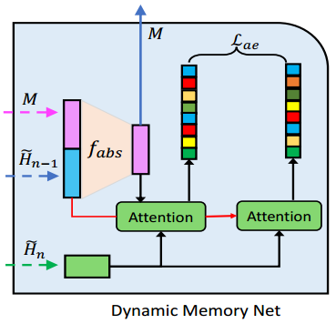
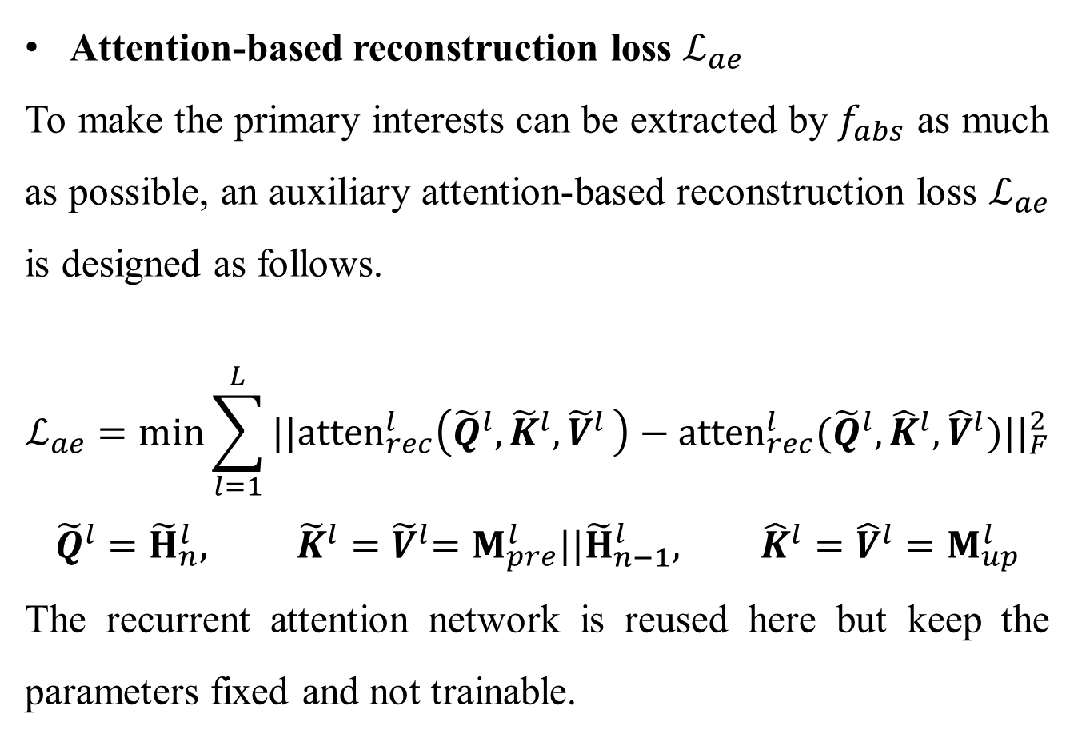
Dynamic Memory Network
Attention-based reconstruction loss $ℒ_{ae}$
To make the primary interests can be extracted by $f_{abs}$ as much as possible, an auxiliary attention-based reconstruction loss $ℒ_{ae}$ is designed as follows.
$$ℒ_{ae}=min\sum_{l=1}^{L}{{||{atten}_{rec}^{l}\left({\tilde{Q}}^{l},{\tilde{K}}^{l}{,\tilde{V}}^{l}\right)−{atten}_{rec}^{l}({\tilde{Q}}^{l},{\hat{K}}^{l},{\hat{V}}^{l})||}_{F}^{2}}$$
$${\tilde{Q}}^{l}={\tilde{H}}_{n}^{l}, {\tilde{K}}^{l}{=\tilde{V}}^{l}=M_{pre}^{l}||{\tilde{H}}_{n−1}^{l}, {\hat{K}}^{l}={\hat{V}}^{l}=M_{up}^{l}$$
The recurrent attention network is reused here but keep the parameters fixed and not trainable.

Slide 10
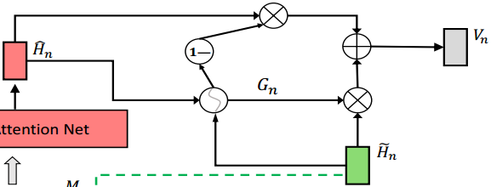
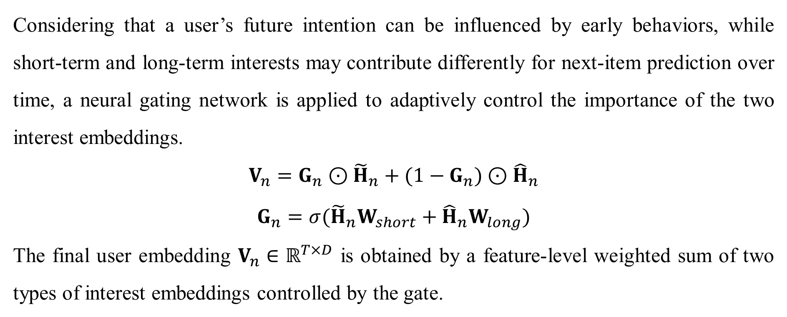
Neural Gating Network
Considering that a user’s future intention can be influenced by early behaviors, while short-term and long-term interests may contribute differently for next-item prediction over time, a neural gating network is applied to adaptively control the importance of the two interest embeddings.
$$V_{n}=G_{n}⊙{\tilde{H}}_{n}+(1−G_{n})⊙{\hat{H}}_{n}$$
$$G_{n}=σ({\tilde{H}}_{n}W_{short}+{\hat{H}}_{n}W_{long})$$
The final user embedding $V_{n}∈ℝ^{T×D}$ is obtained by a feature-level weighted sum of two types of interest embeddings controlled by the gate.

Slide 11
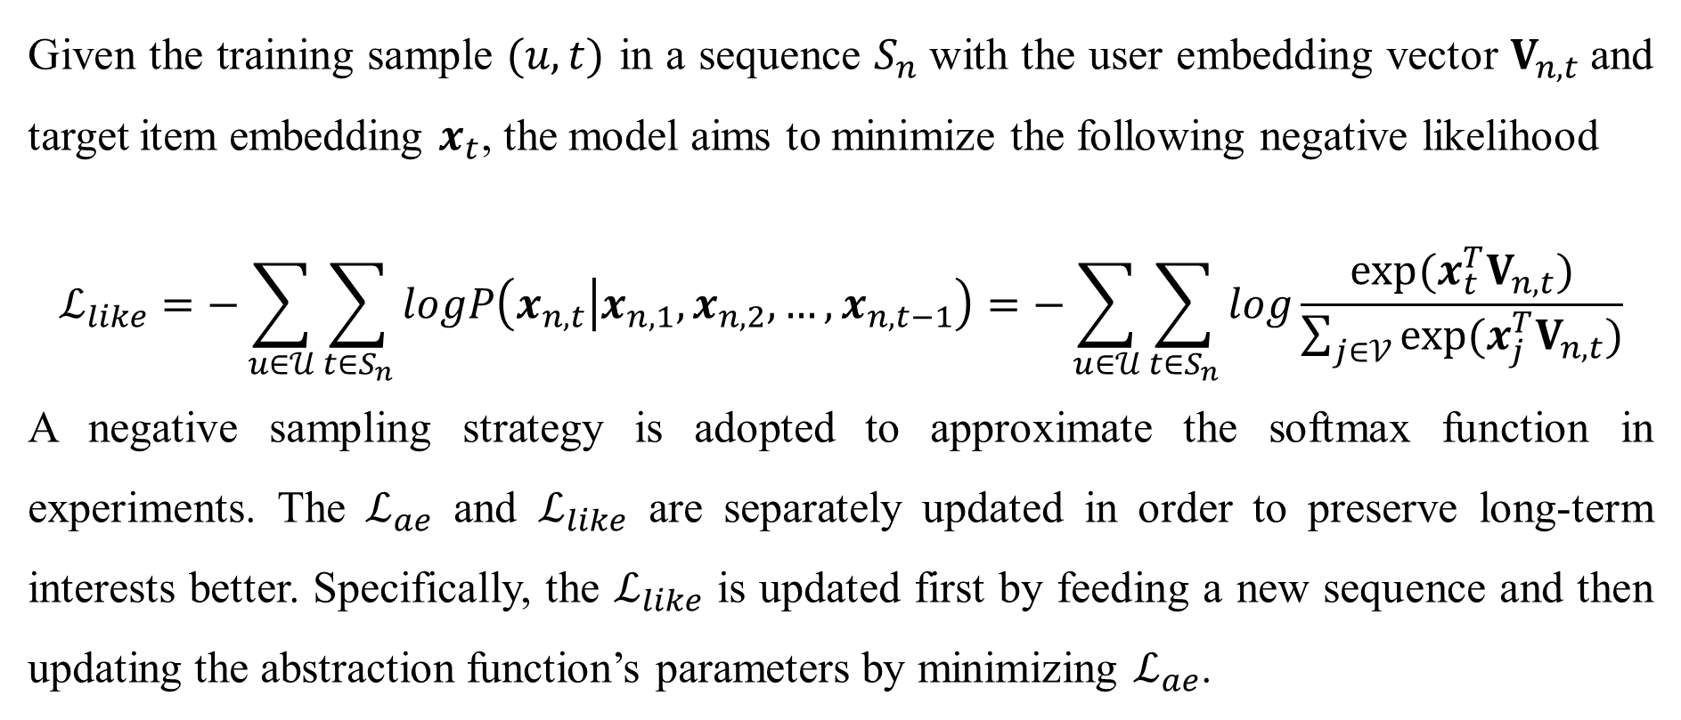
Model Optimization
Given the training sample $(u,t)$ in a sequence $S_{n}$with the user embedding vector $V_{n,t}$and target item embedding $x_{t}$, the model aims to minimize the following negative likelihood
$$ℒ_{like}=−\sum_{u∈𝒰}{\sum_{t∈S_{n}}{logP\left(x_{n,t} | x_{n,1},x_{n,2},…,x_{n,t−1}\right)}=−}\sum_{u∈𝒰}{\sum_{t∈S_{n}}{log\frac{exp⁡(x_{t}^{T}V_{n,t})}{\sum_{j∈𝒱}{exp⁡(x_{j}^{T}V_{n,t})}}}}$$
A negative sampling strategy is adopted to approximate the softmax function in experiments. The $ℒ_{ae}$ and $ℒ_{like}$ are separately updated in order to preserve long-term interests better. Specifically, the $ℒ_{like}$ is updated first by feeding a new sequence and then updating the abstraction function’s parameters by minimizing $ℒ_{ae}$.

Slide 12
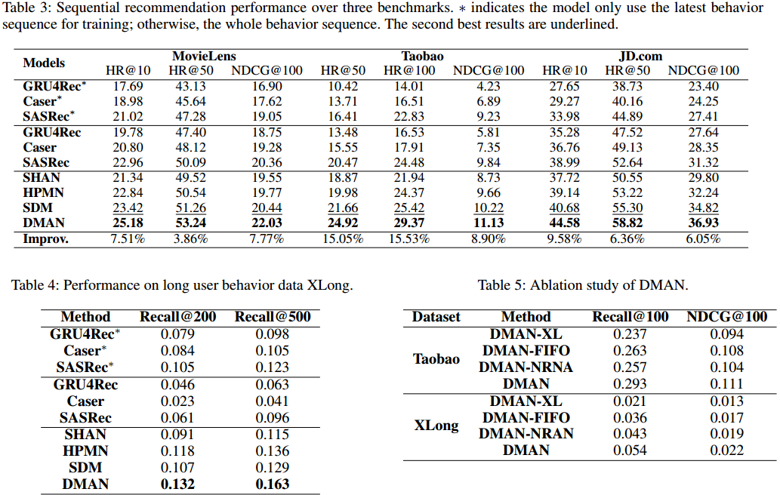
Experiments

Slide 13
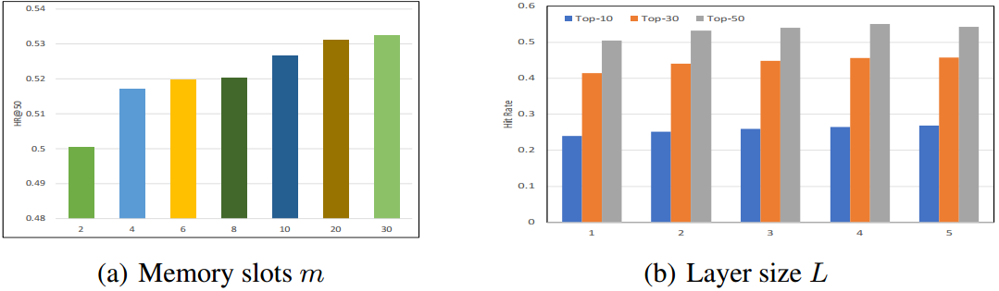
Experiments

